Slide 1
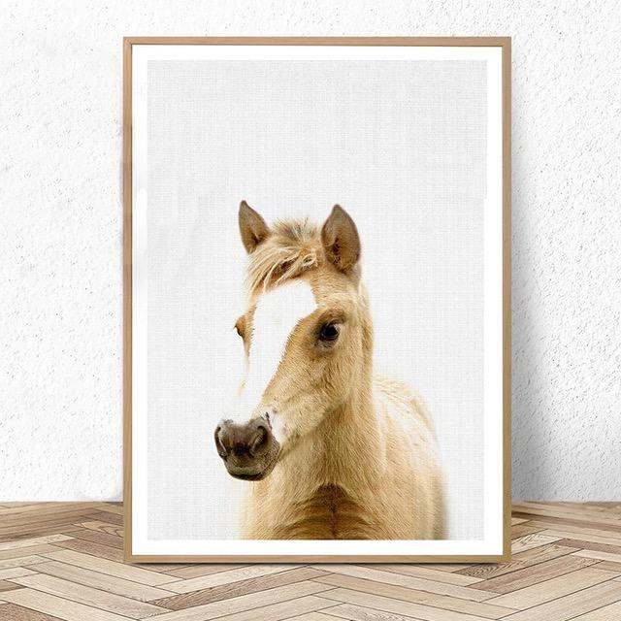
Toy Horse Competition Case
Simon MSMA
Tianyao Liu

Slide 2
Key Findings and Recommendations
Three clusters are selected using benefit segmentation. Profile 4, profile 14 and profile 16 are the respective profiles to target each segment.
Through a priori segmentation, we adopt regression analysis to explore age and gender differences and profile 4, profile 8, profile 12 and profile 16 are more suitable for these segments.
Taken competitor’s market share into consideration, our final recommendation for Early Riders is to drop profile 13, keep profile 5 and add profile 4, which drives profit as high as $258,973 in short term (one year) and $1,321,533 in long term (five year).
As for targeting and promotions, we suggest Early Riders to emphasize on low price when targeting male segment and 2 years-old segment ; to emphasize on suitable horse size when targeting female segment and 3-4 years-old segment.

Slide 3
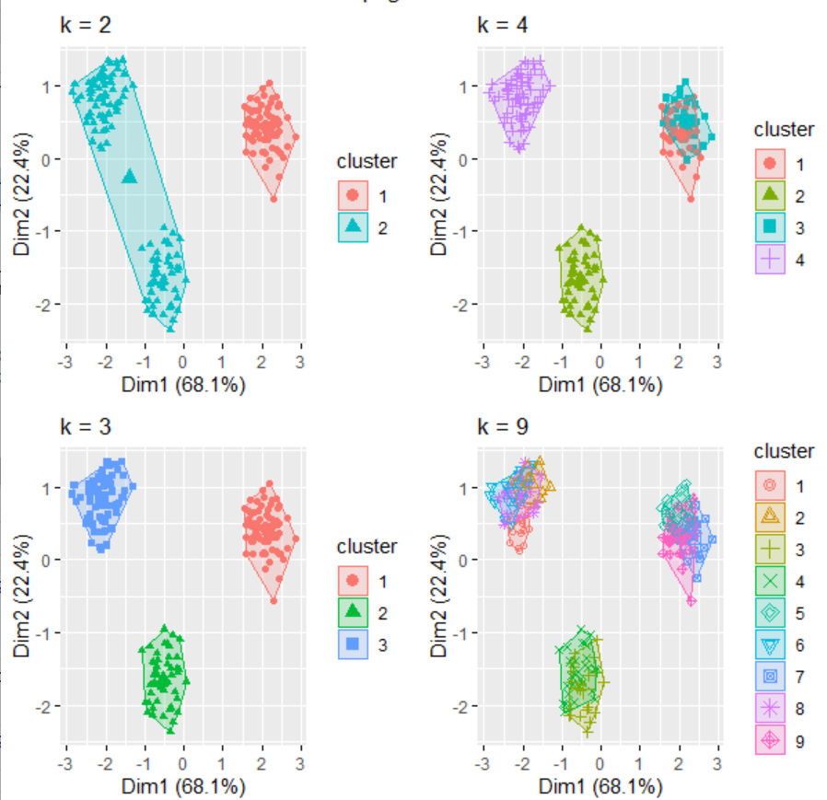
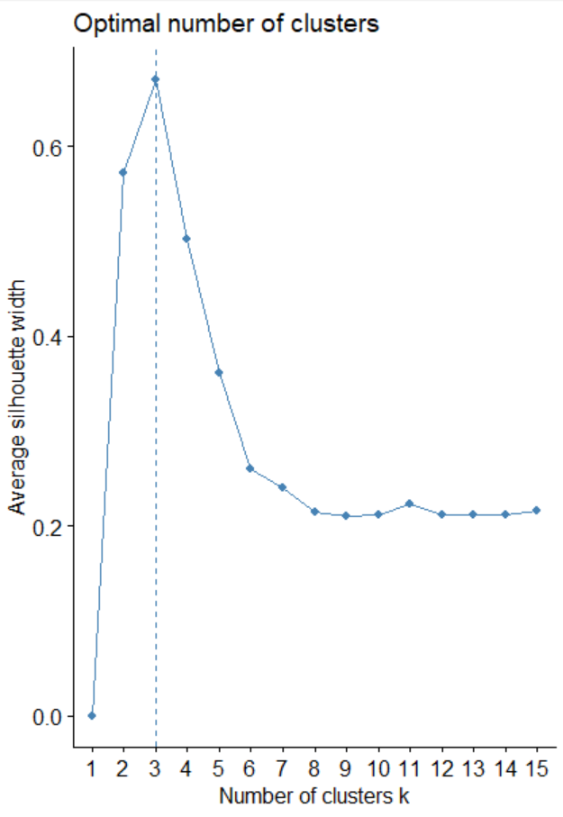
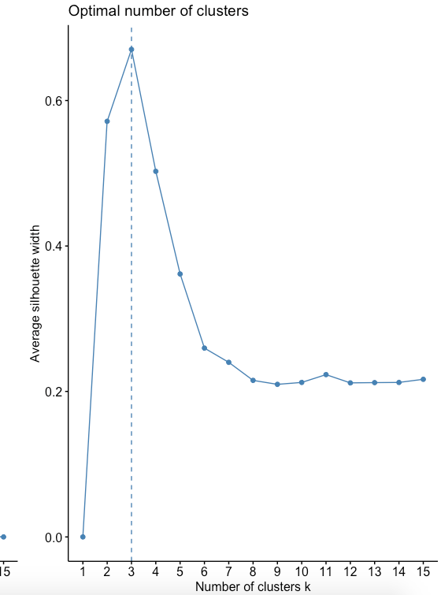
Benefit Segmentation via Cluster Analysis
Test 2, 3, 4, 9 clusters
3 clusters fits the best
Fewer clusters (2) could not separate customers
More clusters (4, 9) causes segmentation overlap
Notes:
# First segment：care about the price most;;prefer 26 inches ; likes bouncing the most; likes racing the most ---- Profile 4
# Second segment:they prefer low price; likes 18-inch one the most; likes rocking the most; kind of prefer glamorous ---- Profile 14
# Third segment: care about the size most. They are the least price sensitive; like 26-inch the most;prefer rocking motion; likes glamorous the most. ---- Profile 16

Slide 4
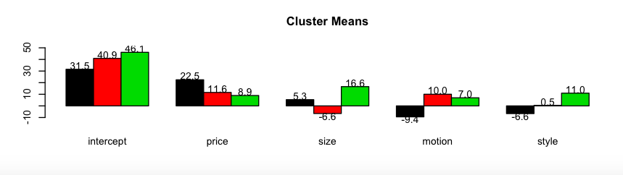
Benefit Segmentation via Cluster Analysis
Profile 4, Profile 14 and Profile 16 are suitable to target three different segments
 | price | size | motion | style | profile
Segment 1 (Black) Low-price ($119.99),,26-inch, bouncing and racing | 1 | 1 | 0 | 0 | 4
Segment 2 (Red) Low-price ($119.99), 18-inch, rocking and glamorous | 1 | 0 | 1 | 1 | 14
Segment 3 (Green) Low-price($119.99), 26-inch, rocking and glamorous | 1 | 1 | 1 | 1 | 16
Note:
Profile 16 is one of the four missing profiles and the part-utilities are based on our predictions, thus, we may need more considerations.
Notes:
# First segment：care about the price most;;prefer 26 inches ; likes bouncing the most; likes racing the most ---- Profile 4
# Second segment:they prefer low price; likes 18-inch one the most; likes rocking the most; kind of prefer glamorous ---- Profile 14
# Third segment: care about the size most. They are the least price sensitive; like 26-inch the most;prefer rocking motion; likes glamorous the most. ---- Profile 16

Slide 5
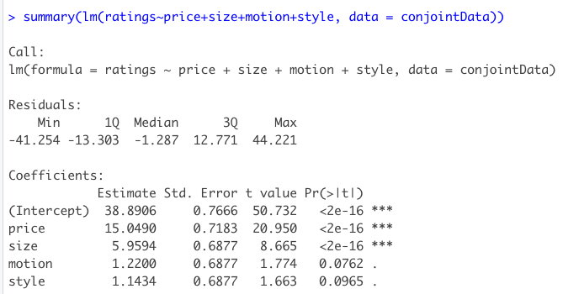
Overall Regression Without Priori Segmentation
Attribute Importance: price > size > motion > style (the importance of motion and style attributes are not significant as price and size).
Overall preferred product: profile 16
Notes:
Price is the most influential
style is the least influential attribute

Slide 6
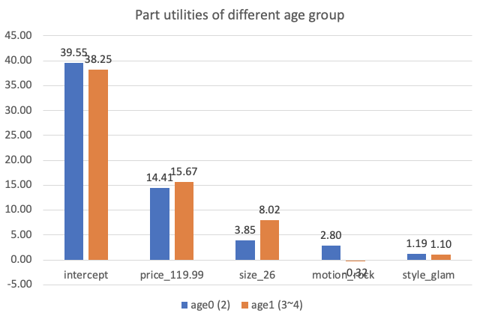
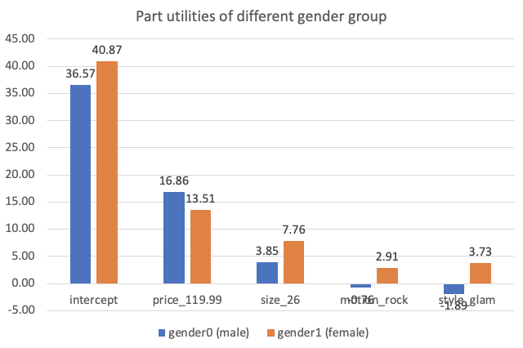
A Priori Segementation with Age and Gender
Parents of 2-year-old children are less price sensitive and also care less about size. Compared to children who are 3-4 years old, 2-year-old children prefer rocking motion over bouncing.
Boys’ parents are more price sensitive with a higher price part-utility while girl’s parents care more about size.
Boys prefer bouncing motion and racing style, while girls prefer rock and glamour style.
All segments prefer low price ($119.99) and bigger size (26 inches).
Attribute Importance: price>size>motion>style, same as without segmentaion.

Slide 7
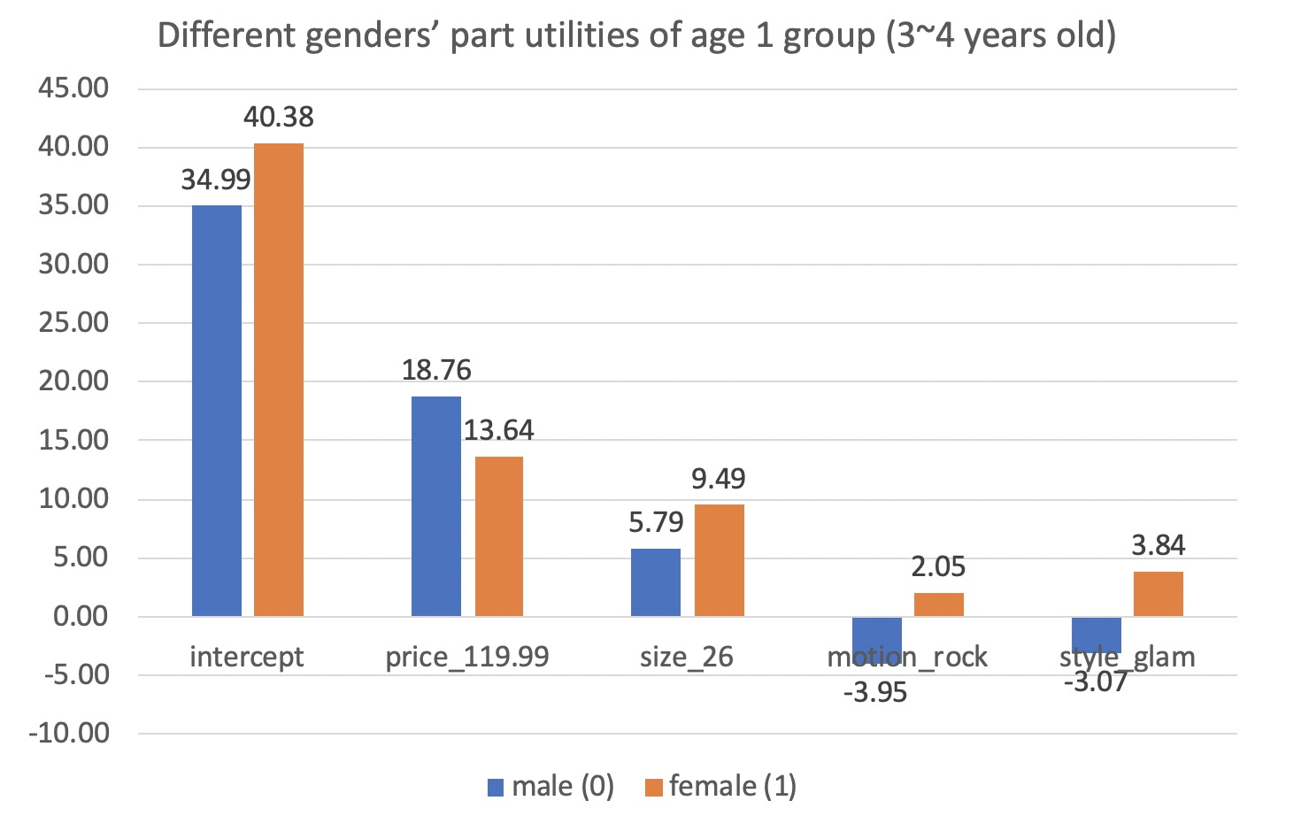
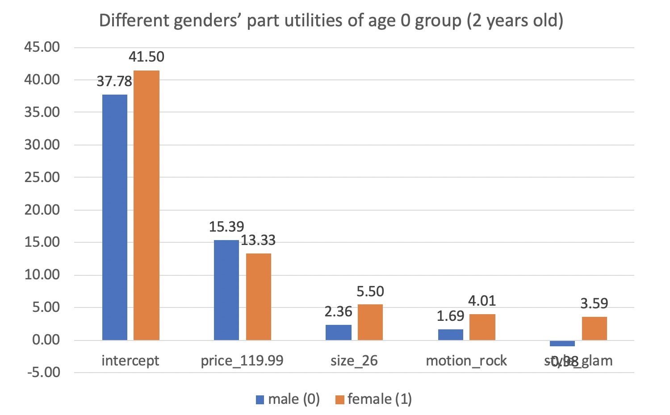
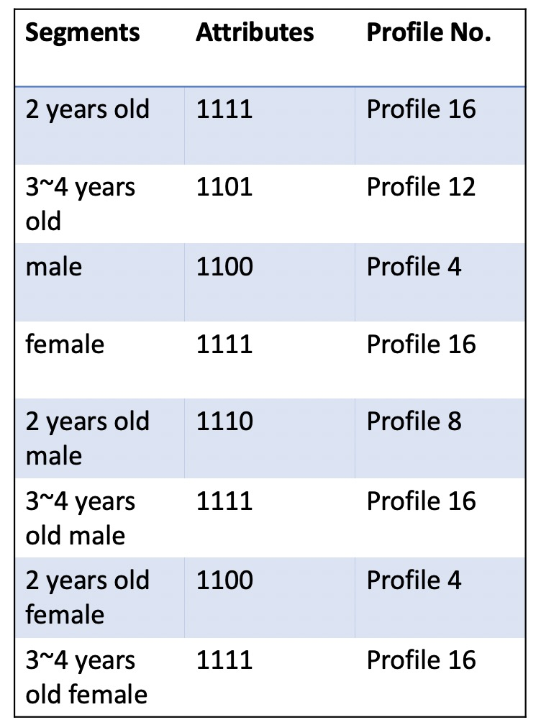
A Priori Segementation with Interactions
Targeting scheme for different segmentations
*1 dimension and 2 dimensions
4 segments: younger boy (2), elder boy (3-4), younger girl (2), elder girl (3-4)
In both age groups, boys’ parents care more about size and price.
2-year-old boys prefer bouncing motion while 3-4 years old boys prefer rock motion, because of their different playing habits.
Profile 4, 8, 12,16 should be launched to target those segments.
Significance Test: Compared to age, gender is a more significant segmentation factor according to the P-value of interacting terms (significant results on three out of four attributes).

Slide 8
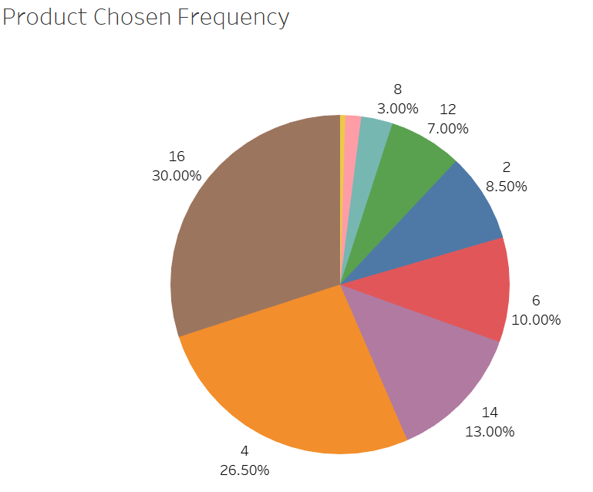
Market Share without Simulation
Step 1: Extract most favorite product for each survey respondent (highest rating).
Step 2: Calculate each product’s market share based on product chosen frequency.
Result: Product 16, product 4 and product 6 are top three products with high market shares while product 15, product 13 and product 8 are three least favorite products.
15 1.05%
13 0.5%

Slide 9
Rationale Behind Developing Scenarios
Scenario 0
Early Rider's profile | competitor's profile | Early Rider's Market share | Early Rider's Profit
5, 13 | 7 | 80.5% | $214,347
Scenario 1: Add 14, 4, 16
Because 14, 4, 16 are best target segments in cluster analysis.
Assumption 1:
As long as we add new product or modify, competitors will publish product 8 instead of product 7 in order to get higher market share with lower price.
Early Rider's profile | competitor's profile | Early Rider's Market share | Early Rider's Profit
4, 5, 13, 14, 16 | 8 | 100% | $187,080
Scenario 2 & Scenario 3: Choose between 13 &14
After looking at cannibalization, 14 and 13 are similar and may cause caniballization.
Early Rider's profile | competitor's profile | Early Rider's Market share | Early Rider's Profit
4, 5, 13 | 8 | 100% | $240,413
4, 5, 14 | 8 | 100% | $231,986
Scenario 4
Either 14 or 13 is not appealing compared with rest product.
Early Rider's profile | competitor's profile | Early Rider's Market share | Early Rider's Profit
4, 5 | 8 | 100% | $258,973
Notes:
Here are our key assumptions when simulating different scenarios. First, when Early Riders keep our status quo (Profiles 5 and 13), the only competitor would keep his status quo (Profile 7); when Early Riders add one or more new product line, the competitor would take the action of lowering retail price to $119.99 (which is Profile 8). Second, we assume that Early Riders do not offer Profiles 7 and 8, which are only provided by the competitor in the market.
We add Profiles 4, 14, and 16 because the cluster analysis in Part B suggest that the three segments prefer Profiles 4, 14 and 16 respectively.
We add Profile 12 into consideration because in the A Priori Segmentation analysis in Part C, the preferred profiles according to age and gender (respectively) are Profiles 4, 16, 12, and 8. Since we have already considered Profiles 4 and 16 from Part B and only competitor is offering Profile 8, we add Profile 12 for a more comprehensive analysis.

Slide 10
Rationale Behind Developing Scenarios (Con’t)
Scenario 5: Replace 5 with 12
According to analysis, 3-4 years old children prefer profile 12. Including profile 12 to see if it would increase our market share.
Assumption 2:
Early Riders do not offer Profiles 7 and 8, which are only provided by the competitor.
Early Rider's profile | competitor's profile | Early Rider's Market share | Early Rider's Profit
4, 5, 12 | 8 | 100% | $187,080
Scenario 6 & Scenario 7
Change the profile combination to find out which combination can bring less conniblization and yield higher profit
Early Rider's profile | competitor's profile | Early Rider's Market share | Early Rider's Profit
4, 12 | 8 | 100% | $214,348
5, 12 | 8 | 100% | $214,348
Notes:
We add Profiles 4, 14, and 16 because the cluster analysis in Part B suggest that the three segments prefer Profiles 4, 14 and 16 respectively.
We add Profile 12 into consideration because in the A Priori Segmentation analysis in Part C, the preferred profiles according to age and gender (respectively) are Profiles 4, 16, 12, and 8. Since we have already considered Profiles 4 and 16 from Part B and only competitor is offering Profile 8, we add Profile 12 for a more comprehensive analysis.

Slide 11
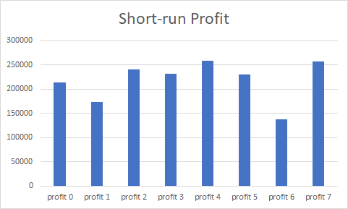
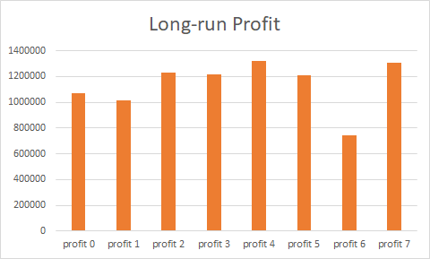
Simulated Short-run & Long-run Profitability
The profit of senario 4 is the highest in both short-run and long-run.
Notes:
We calculated the profits of the 7 scenarios for short-run and long-run respectively. It turns out senario 4 can provide the highest profit during both periods. Over two hundred and fifty-eight thousand dollars for short run that is one year, and one million three hundred and twenty-one thousand dollars for the long run that is five years.

Slide 12
Considerations on Giving Recommendation
Competitive Response
Competitors owns nearly 0 market share in our recommendation
Targeting
Target consumer segments with different product
Cannibalization
In market simulation, too many profiles will cause cannibalization
Long-Term Profit
Long Term profits rank the same with that of short term because revenue and fixed costs increase simultaneously
With only two products provided, we may lose some consumer segments, but may also achieve higher profit
Limitation
Notes:
In the end, we considered from 5 aspects to give EarlyRiders its product line recommendation. As the competitor will possess nearly zero market share after the company launches our recommended profiles, their response of turning to profile 8 is negligible to us. We suggest EarlyRiders to launch several but not too many profiles together to target different consumer segments but avoid too much cannibalization. For/ the long-term profits of different scenarios are basically consistent with the short-term, so for now EarlyRiders does not need to care much about the impact of time on their profitablity. The limitation of our recommended scenario is that the company may lose some consumer segments by providing only two products, but since the company mentioned they are interested in profitability ultimately, scenario 4 with highest profit is acceptable.

Slide 13
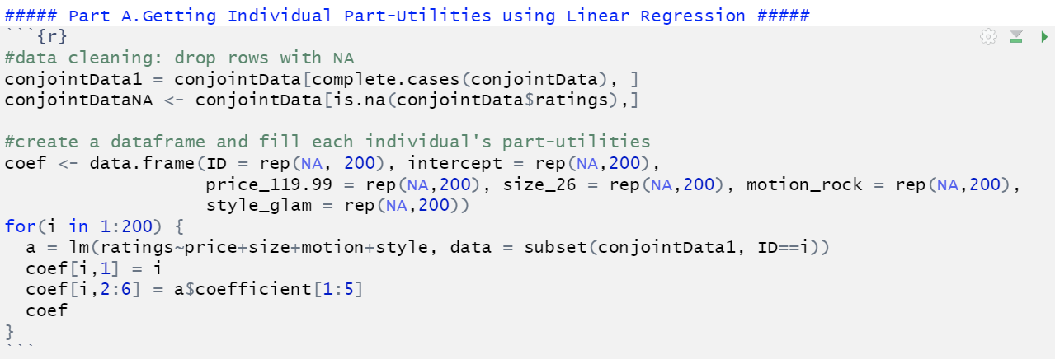
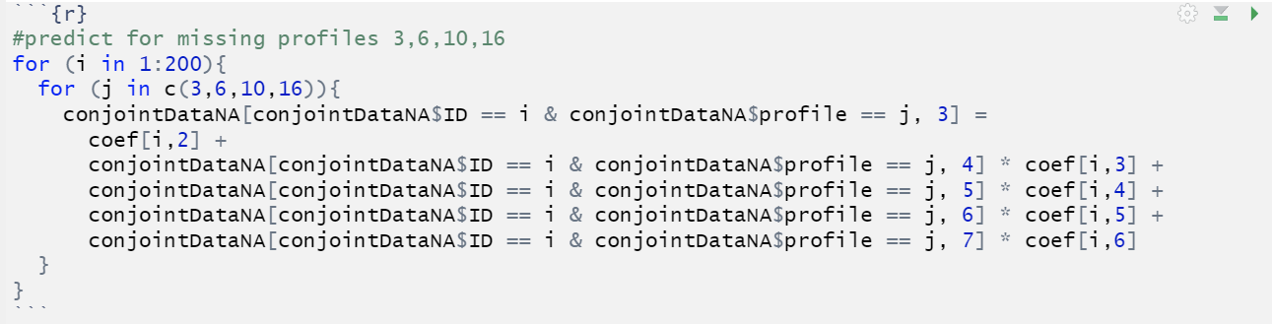
Appendix - Part A

Slide 14
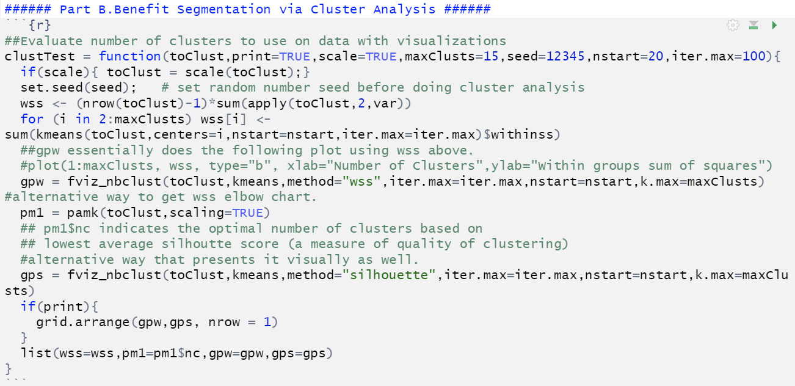
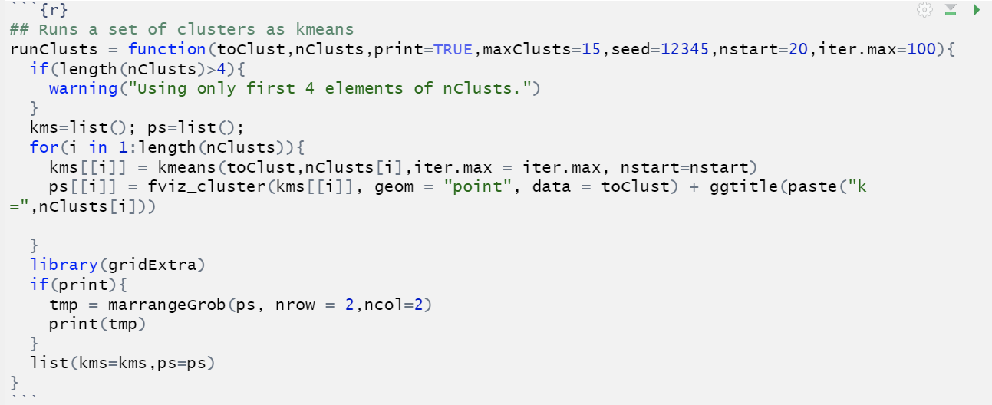
Appendix - Part B

Slide 15
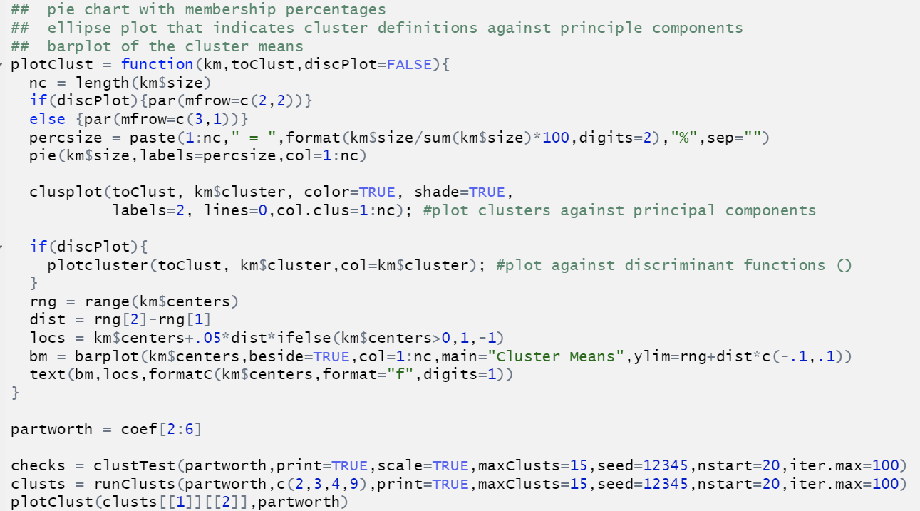
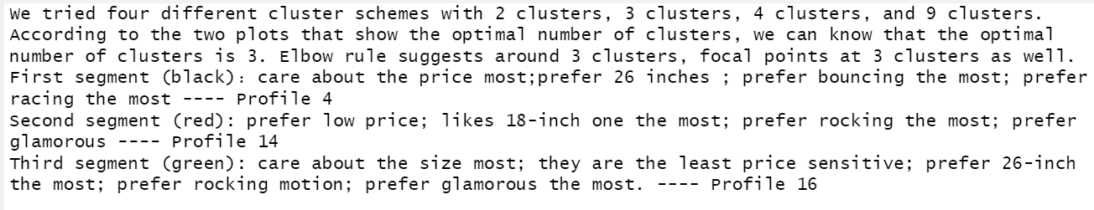
Appendix - Part B (Con’t)

Slide 16
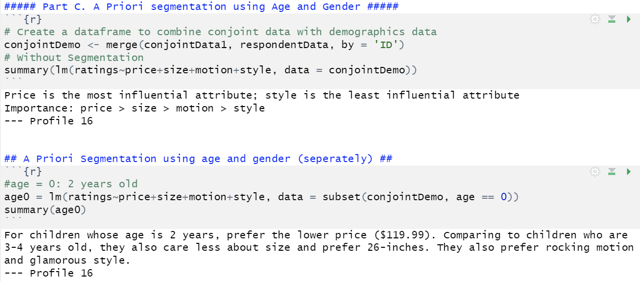
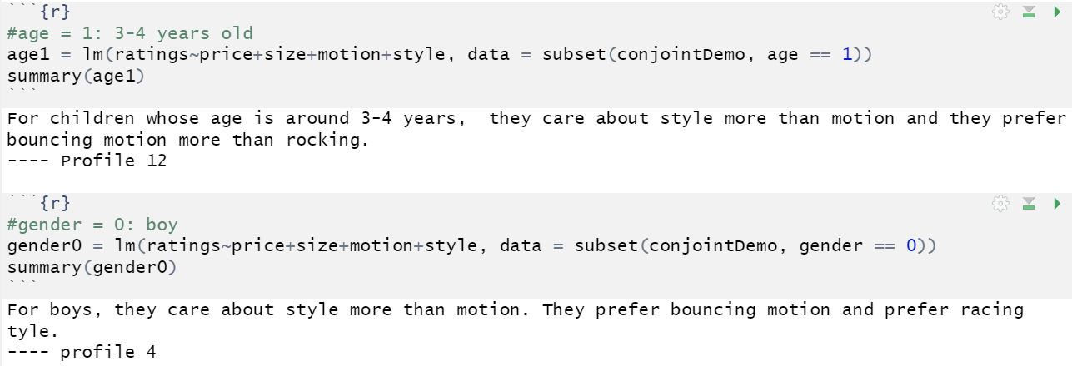
Appendix - Part C

Slide 17
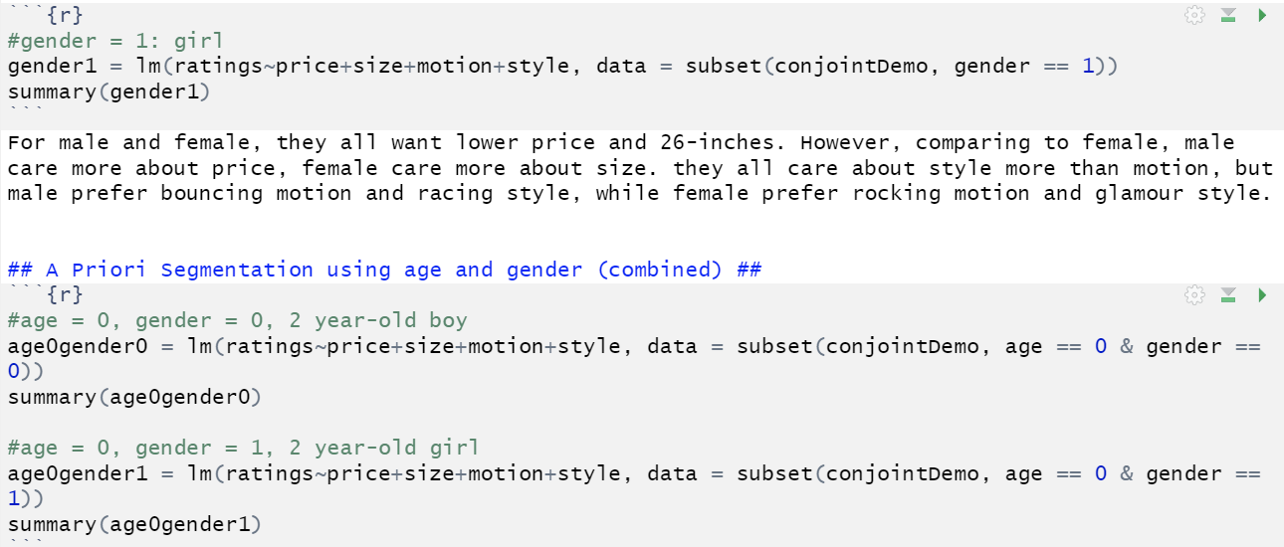
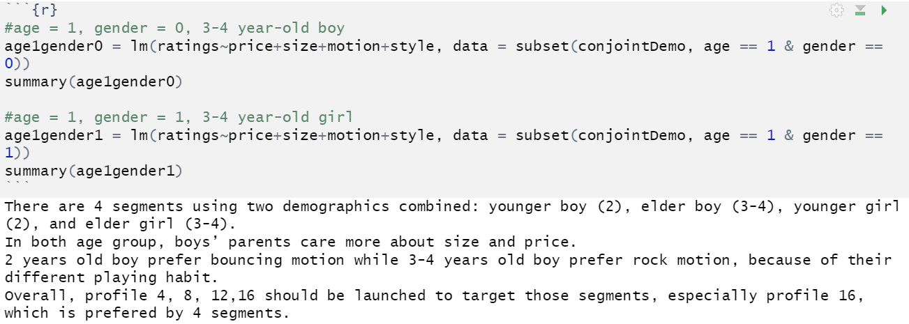
Appendix - Part C (Con’t)

Slide 18
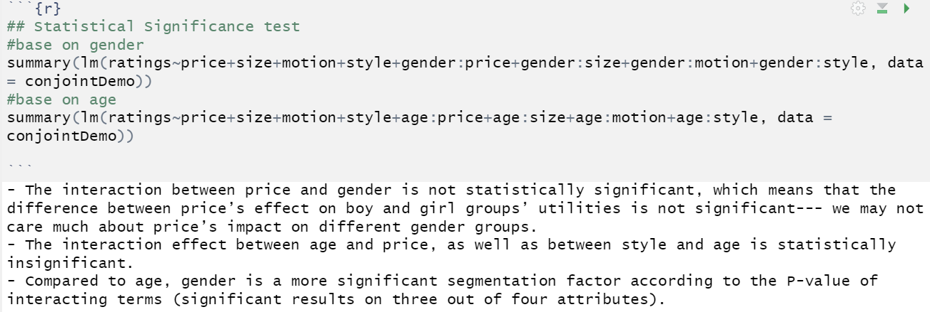
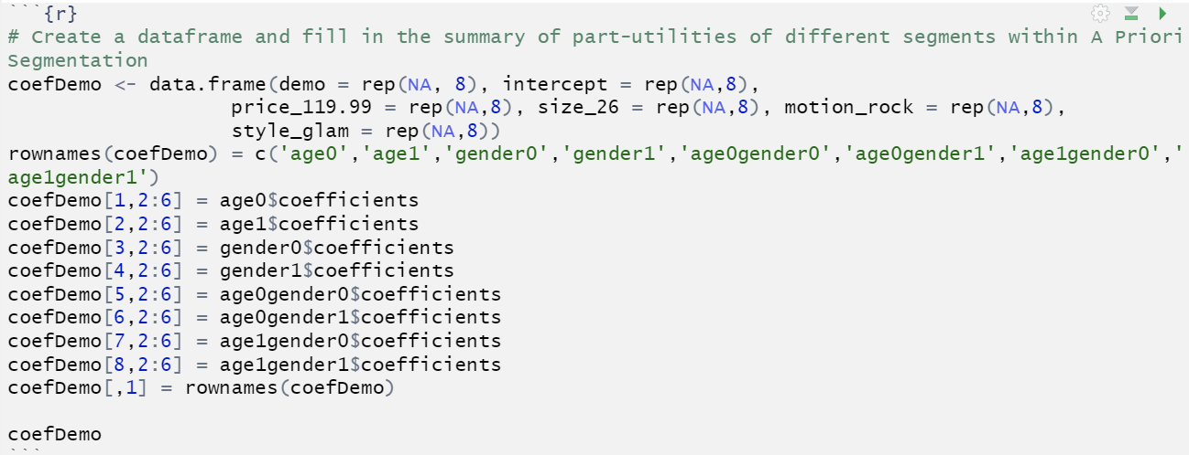
Appendix - Part C (Con’t)

Slide 19
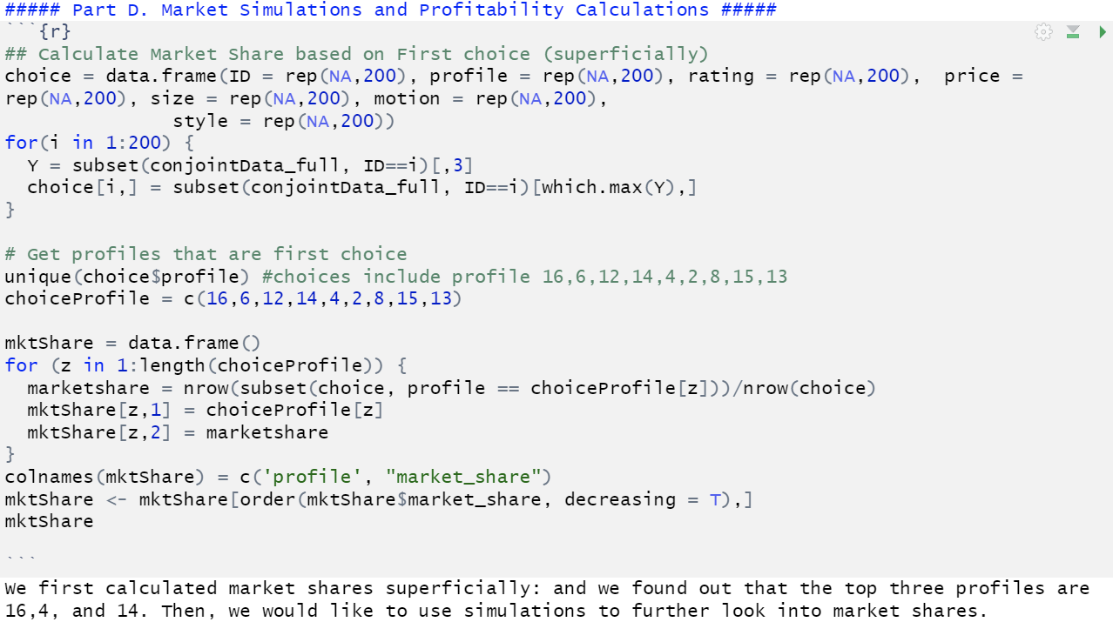
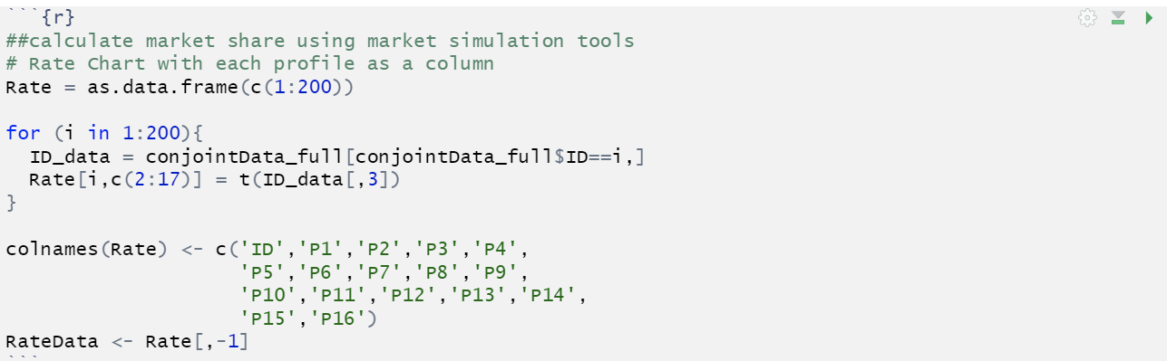
Appendix - Part D

Slide 20
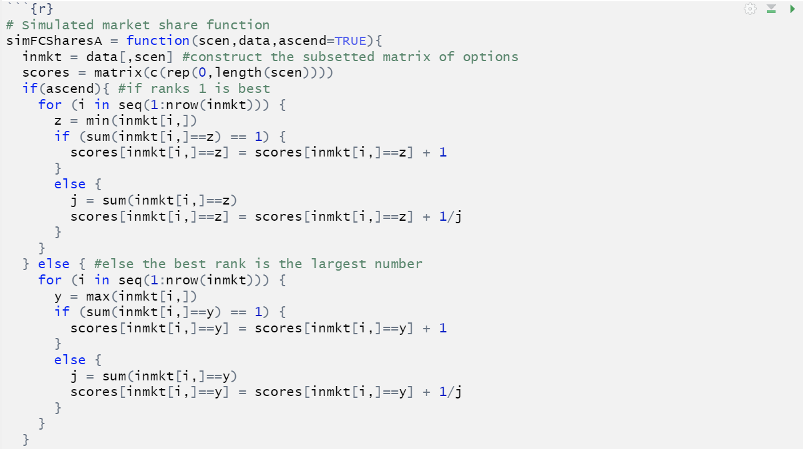
Appendix - Part D (Con’t)

Slide 21
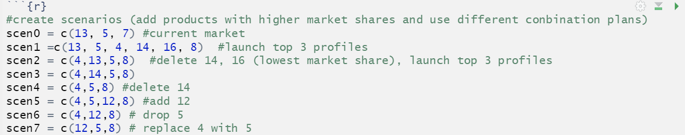
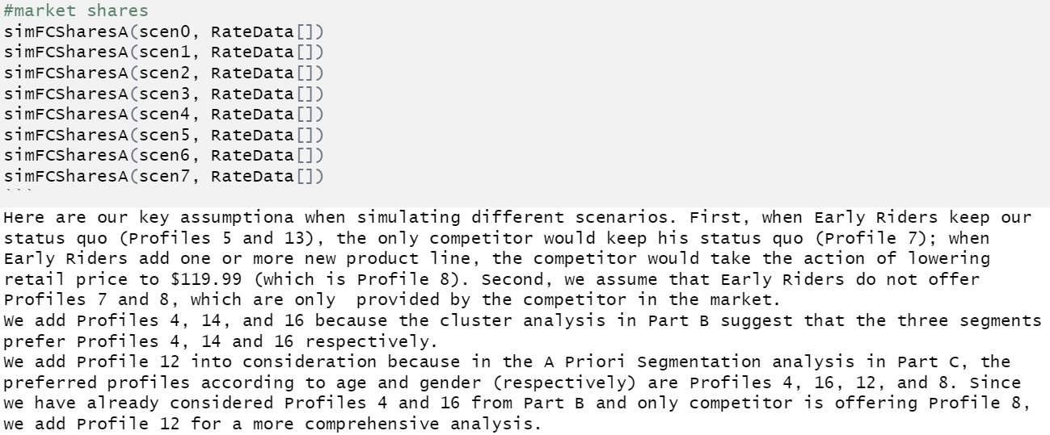
Appendix - Part D (Con’t)

Slide 22
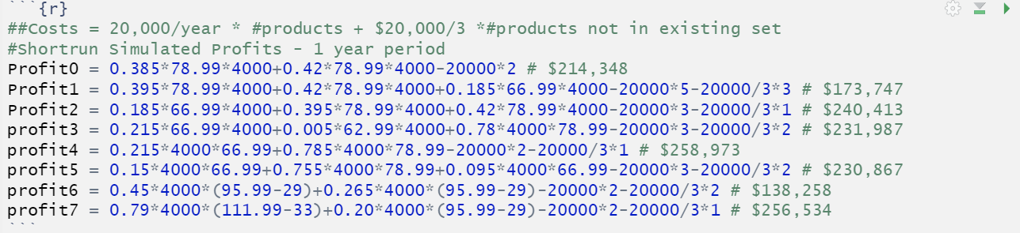
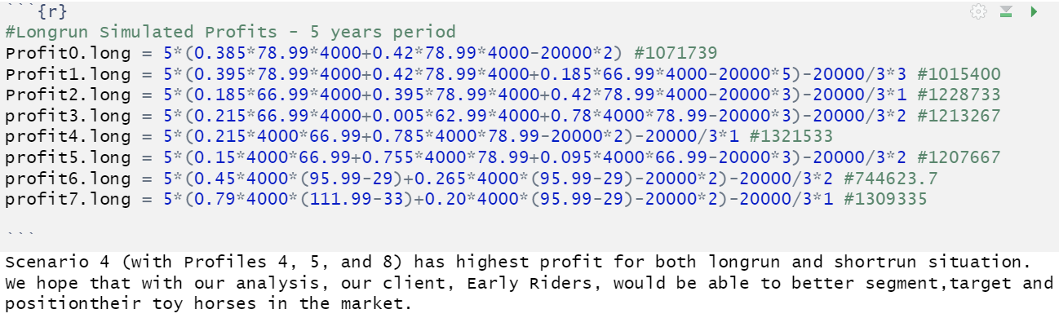
Appendix - Part D (Con’t)

